Slide 1
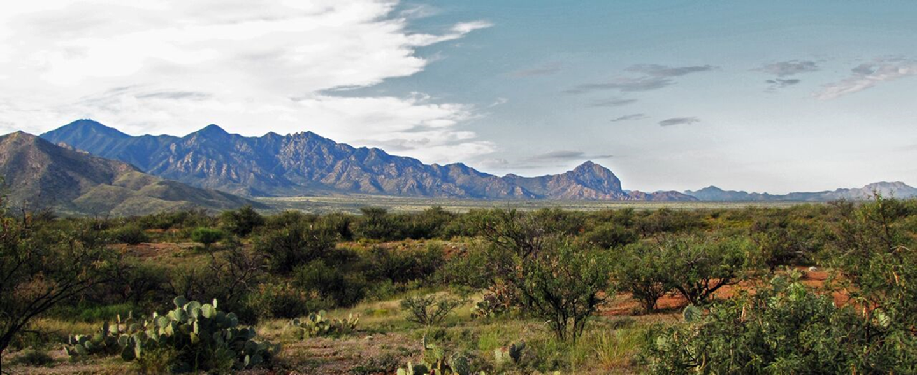



Land Cover Change in Southwestern Deserts
Rayanna K. Benally
Mentors: Dr. Steve Archer & Dr. Adam Naito
College of Agriculture and Life Sciences
NASA Space Grant Symposium, Tucson, AZ
April 15-16 2016
credit: Dr. Adam Naito, SNRE, UA

Slide 2

Introduction___________________________
Woody encroachment threatens rangelands and their sustainability.
Concerns for the ranching industry.
Rangelands cover 40% of the earths surface.
credit: Dr. Adam Naito, SNRE, UA

Slide 3
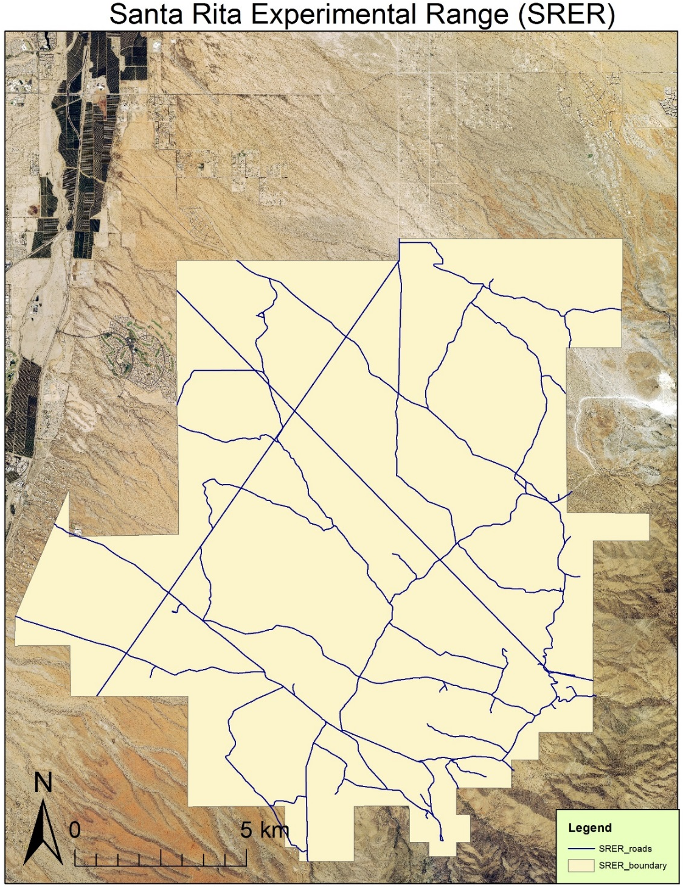
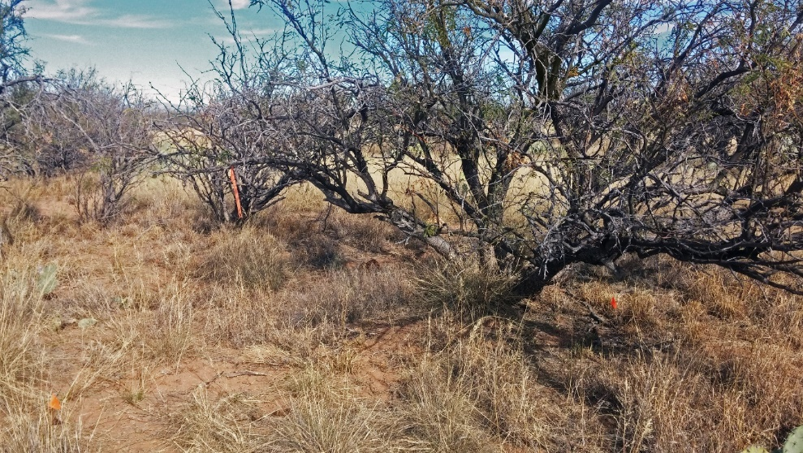

Established in 1903.
40 km (25 miles) South of Tucson.
Long term records vegetation and grazing schemes.
Been encroached by velvet mesquite (Prosopis velutina).

Slide 4
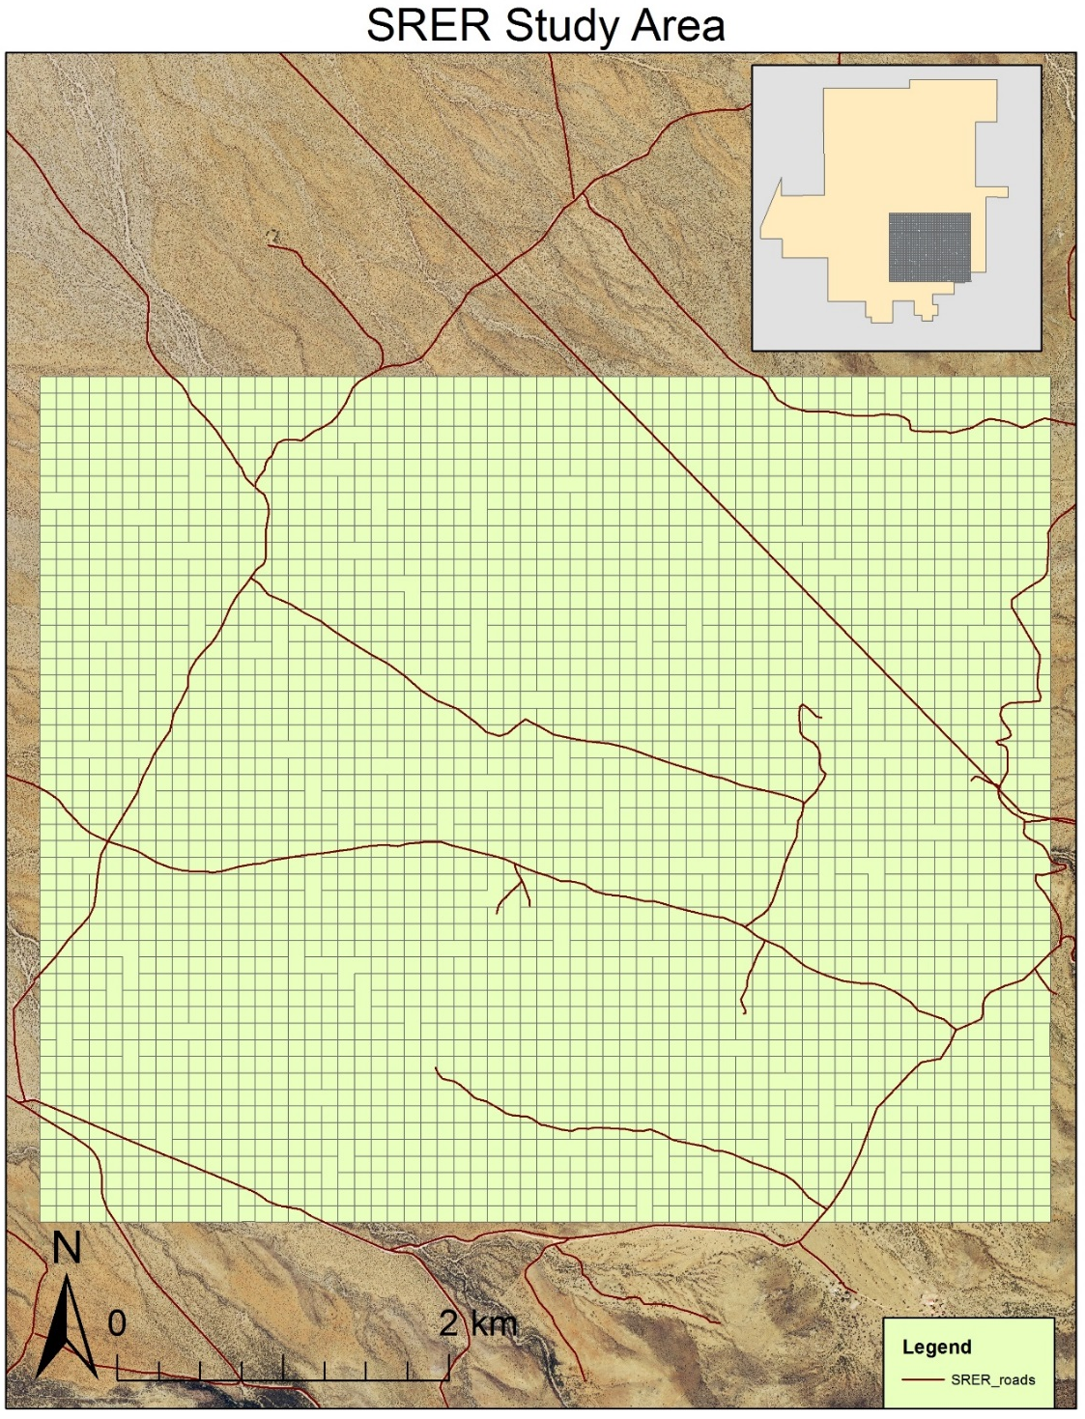
Research Area_____
12 square mile area of semi-desert grassland of the SRER.
How did mesquite cover change over time?
How does mesquite respond to disturbances?

Slide 5
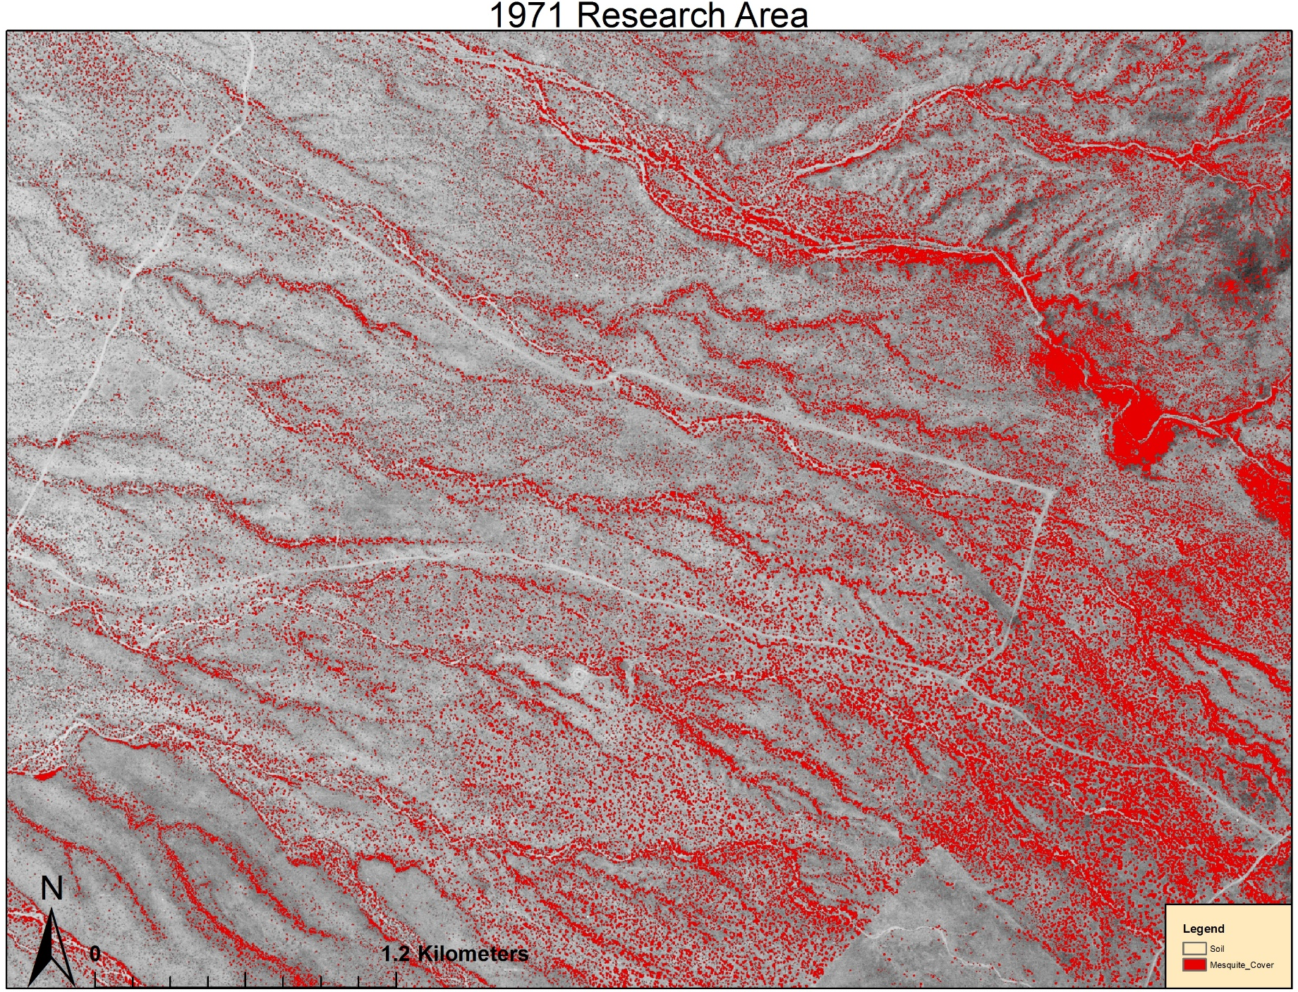
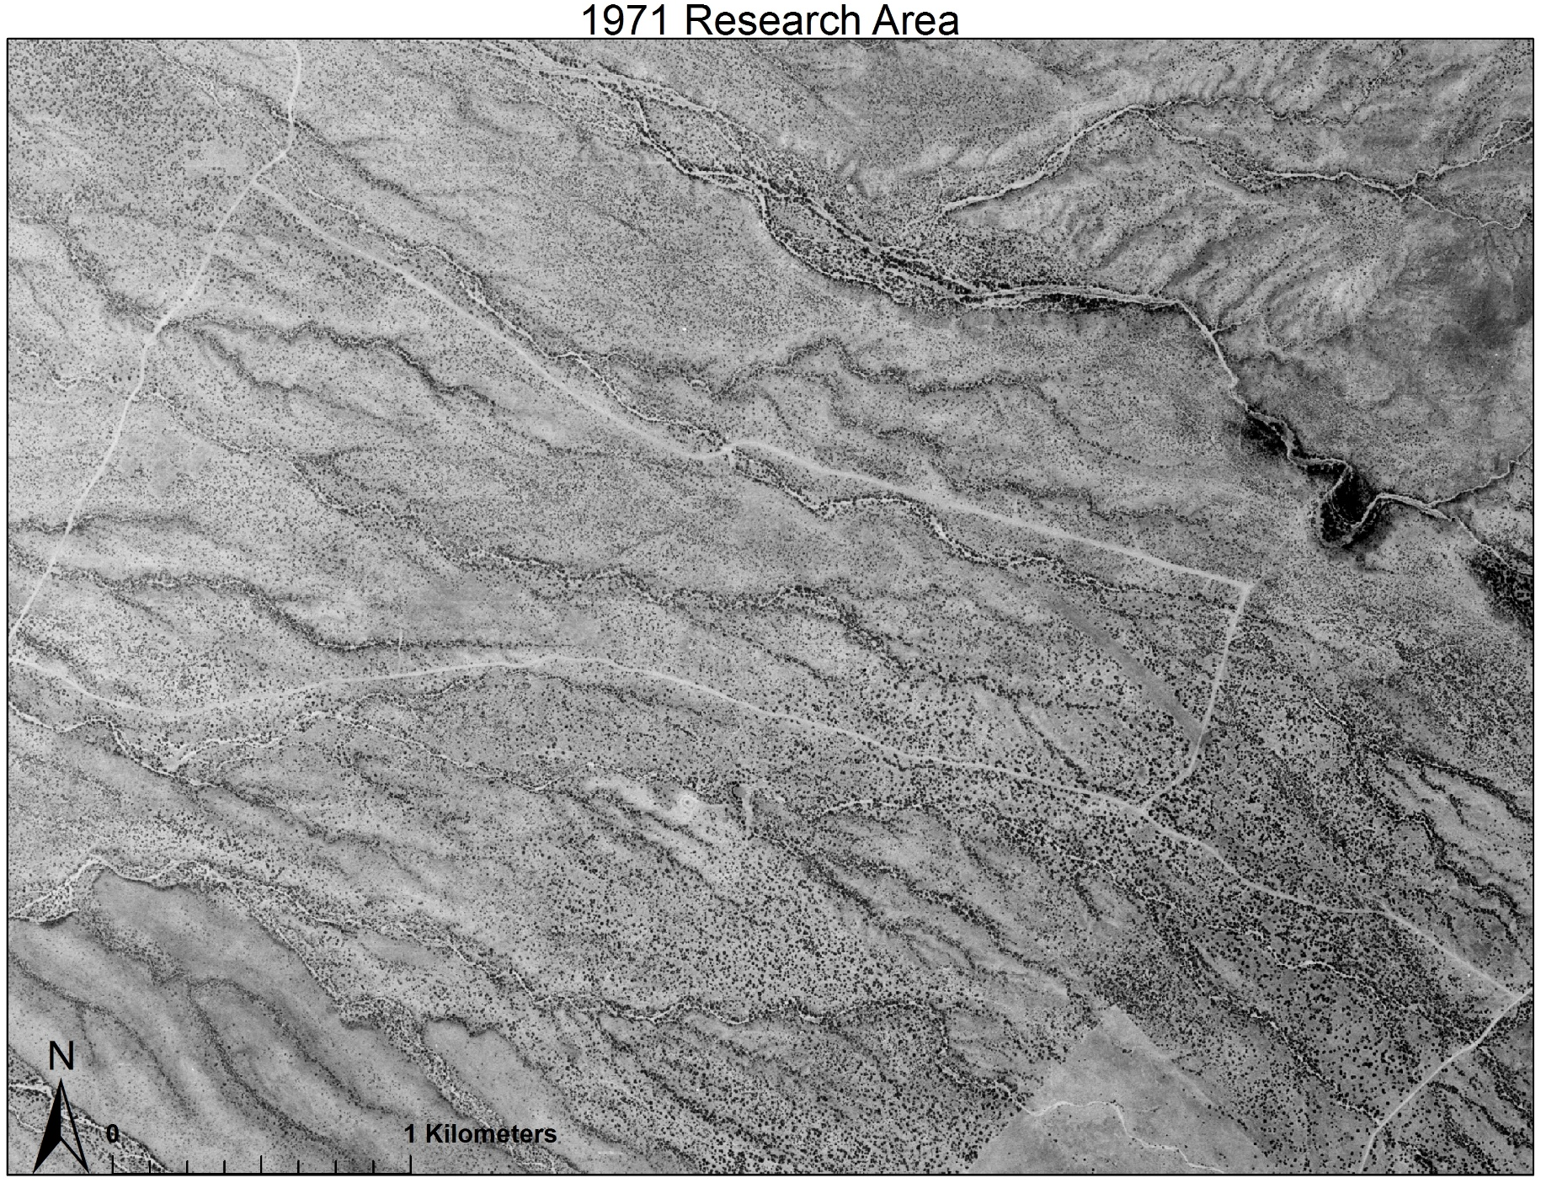
Methods
Used 6 aerial images of the SRER from 1971-2013.
Referenced photos using GIS software.
Classified imagery to identify mesquite.
Quantified percent cover of mesquite over time.

Slide 6
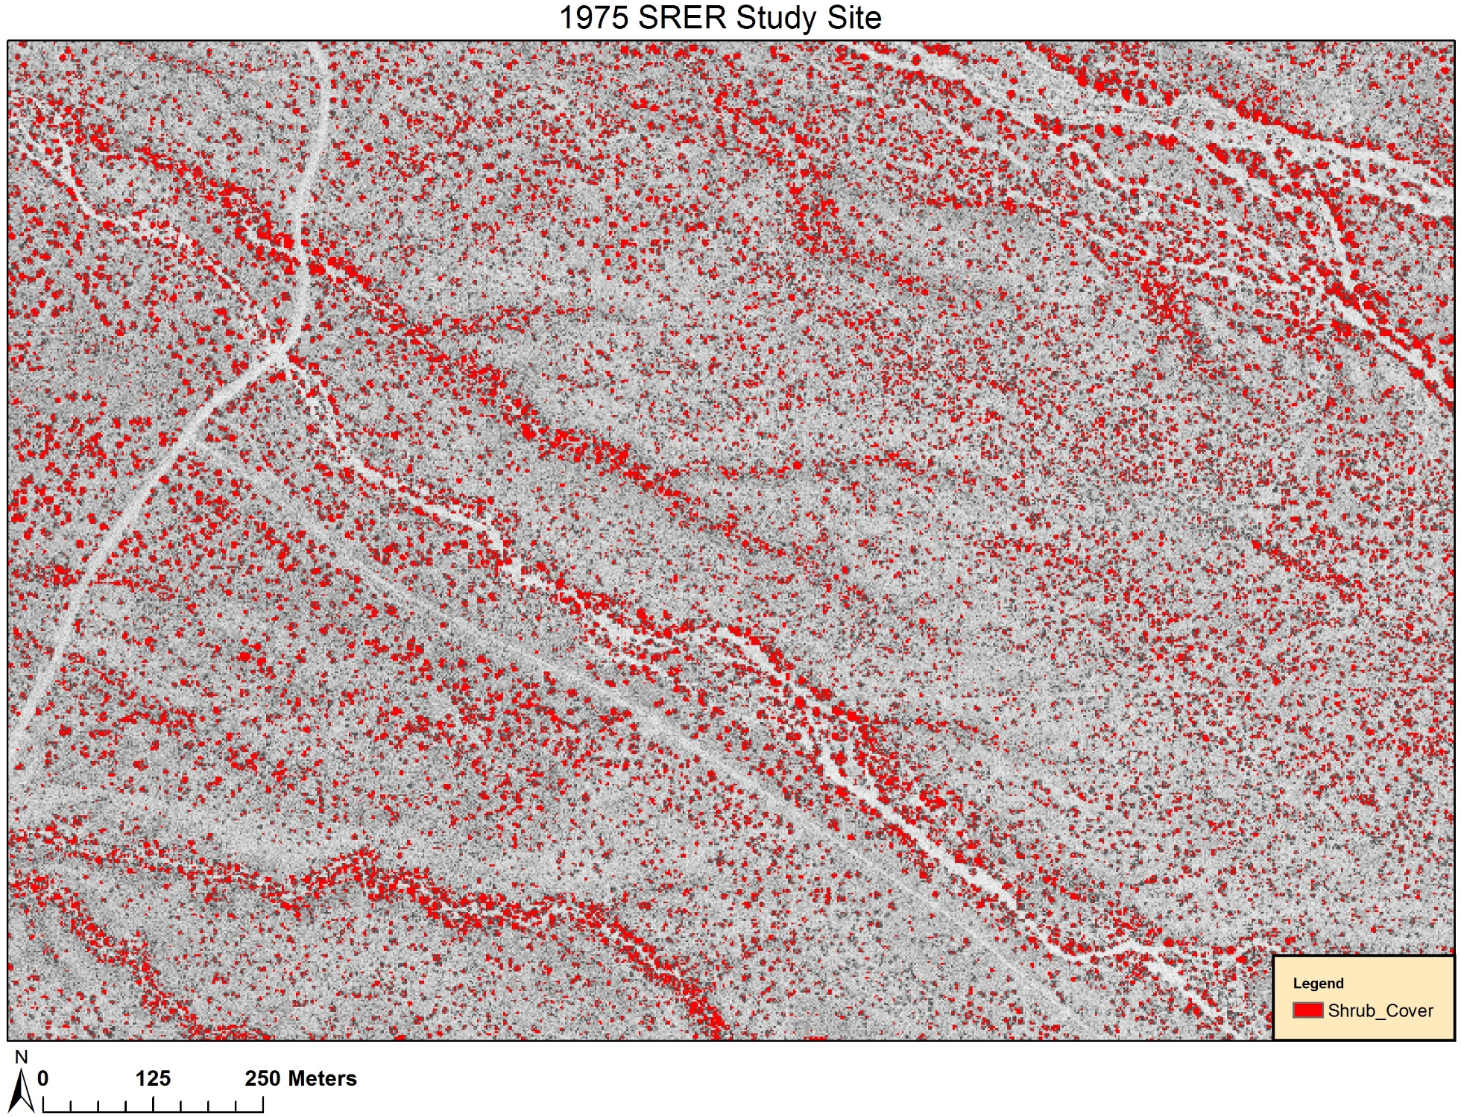
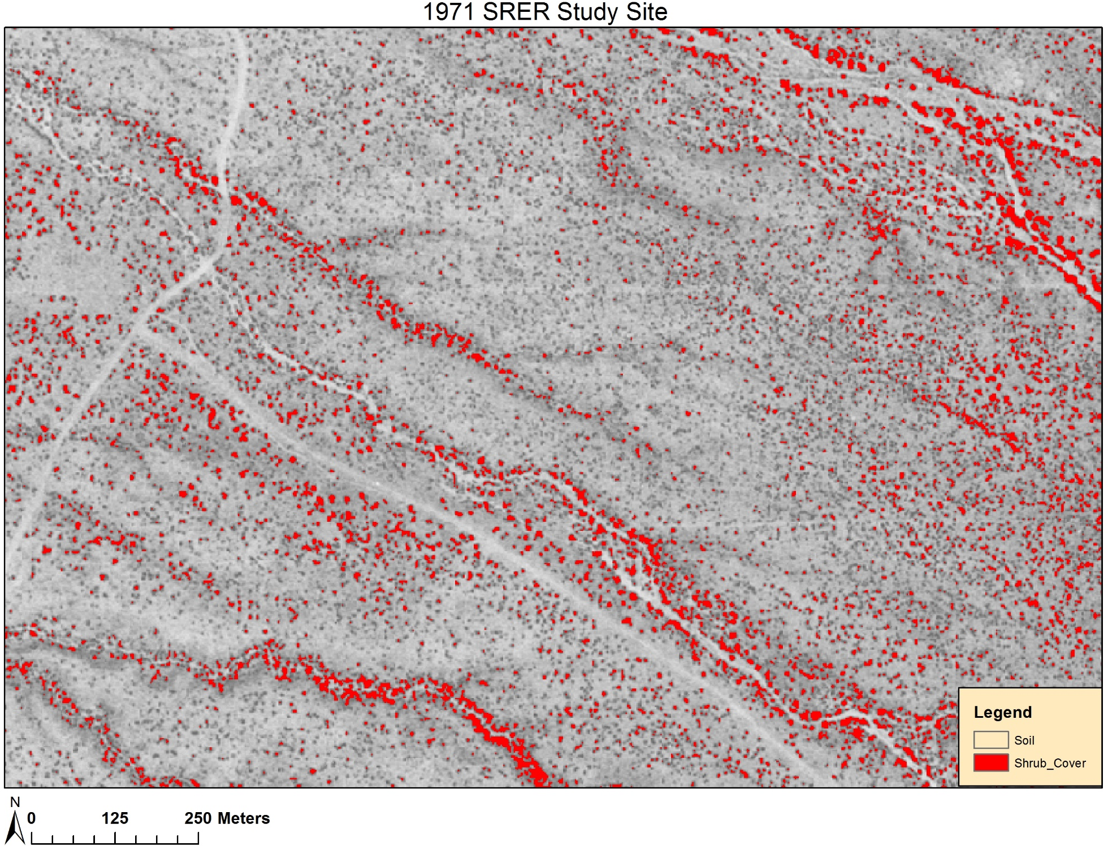
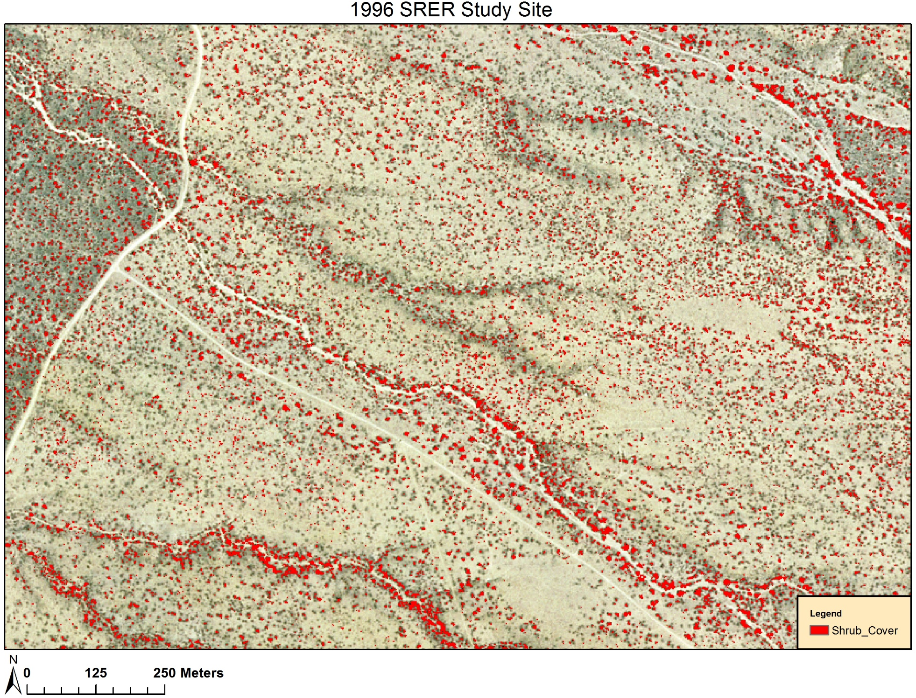
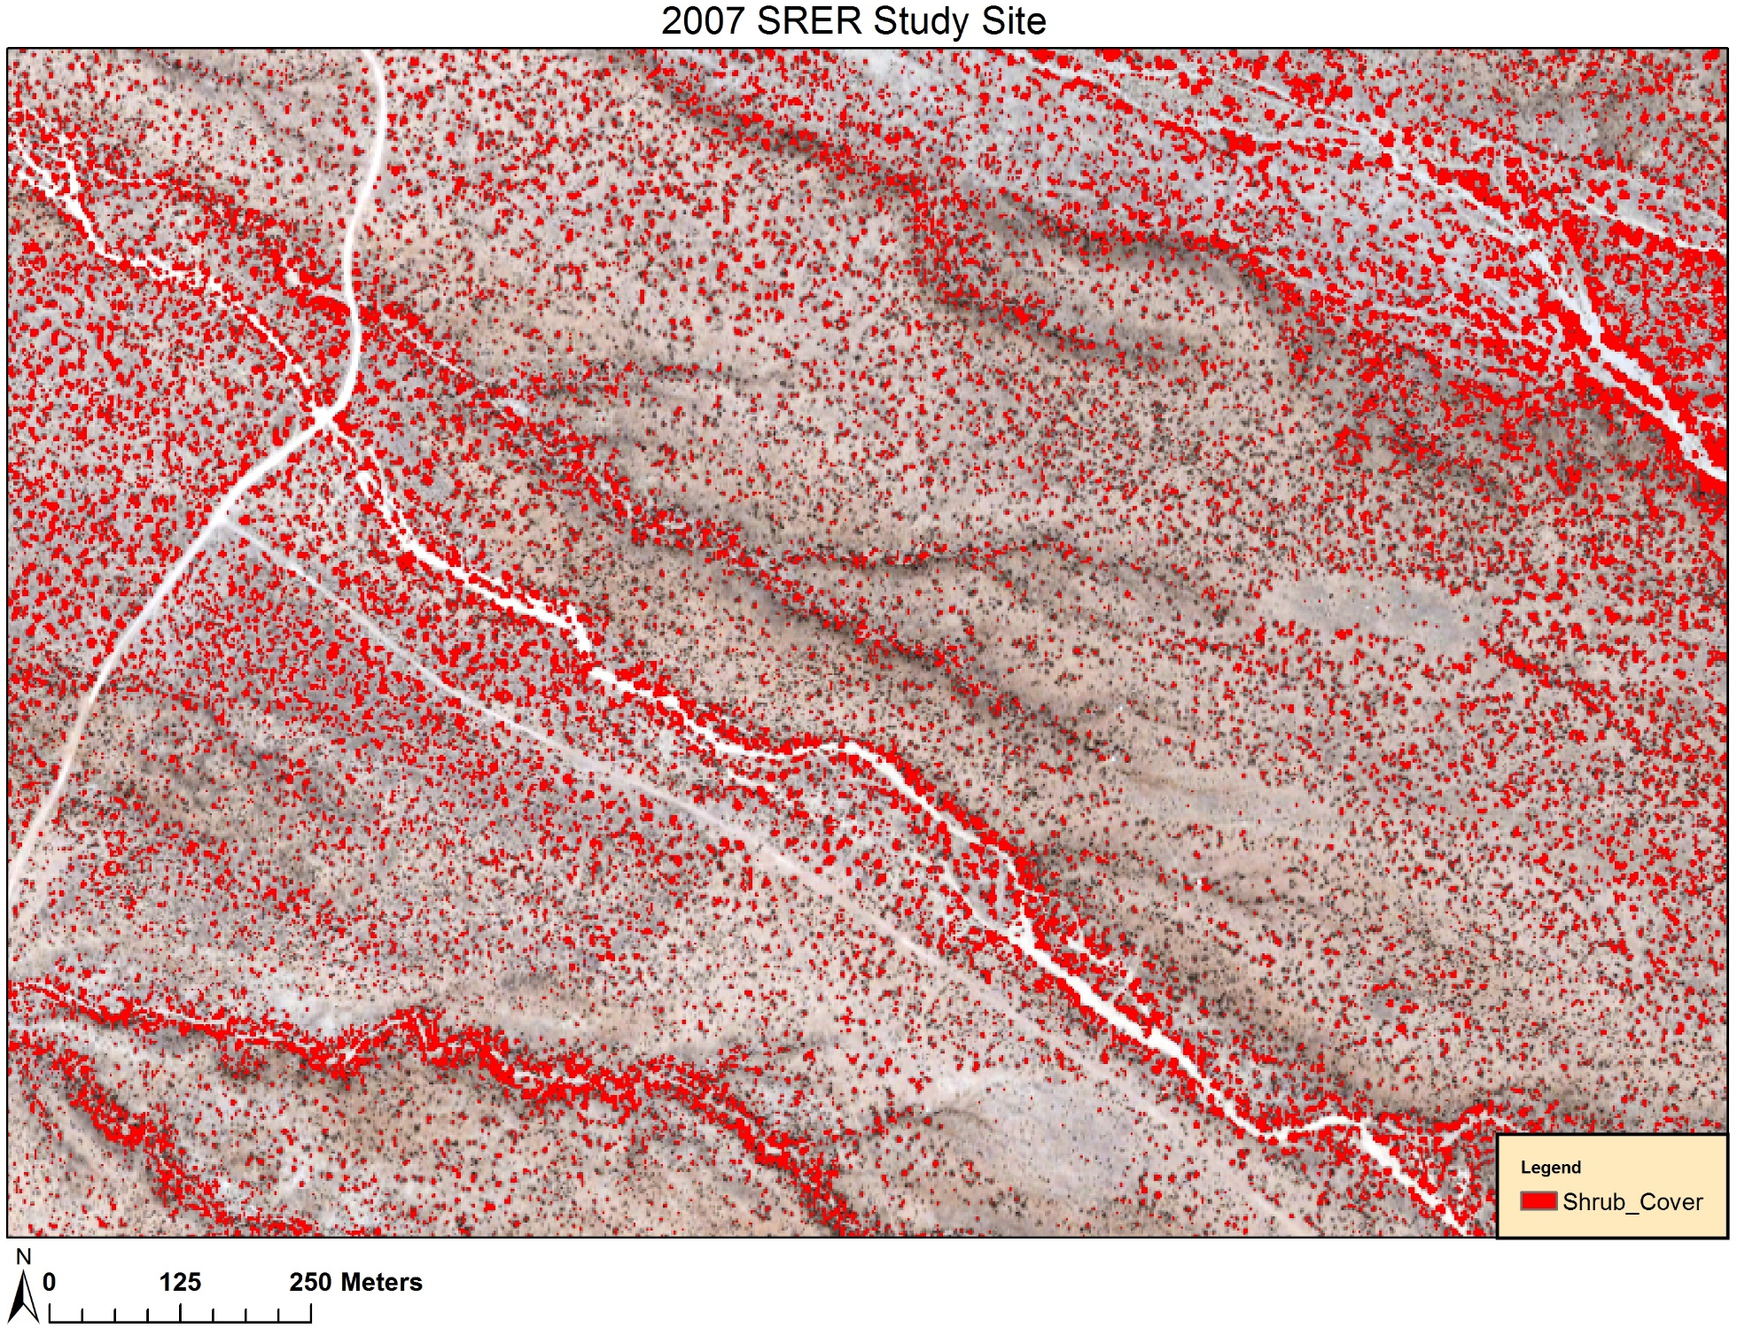
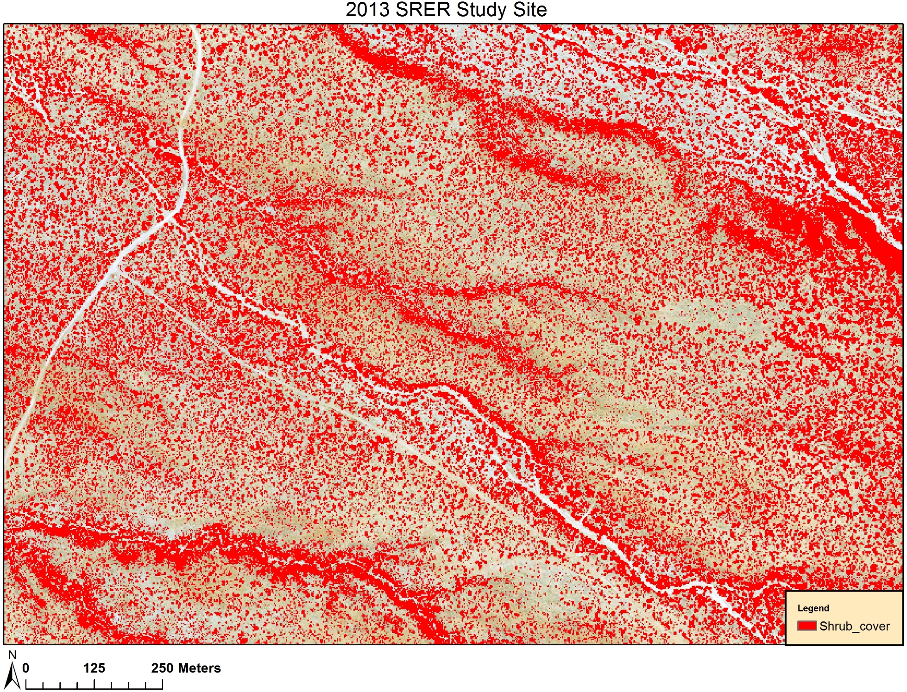
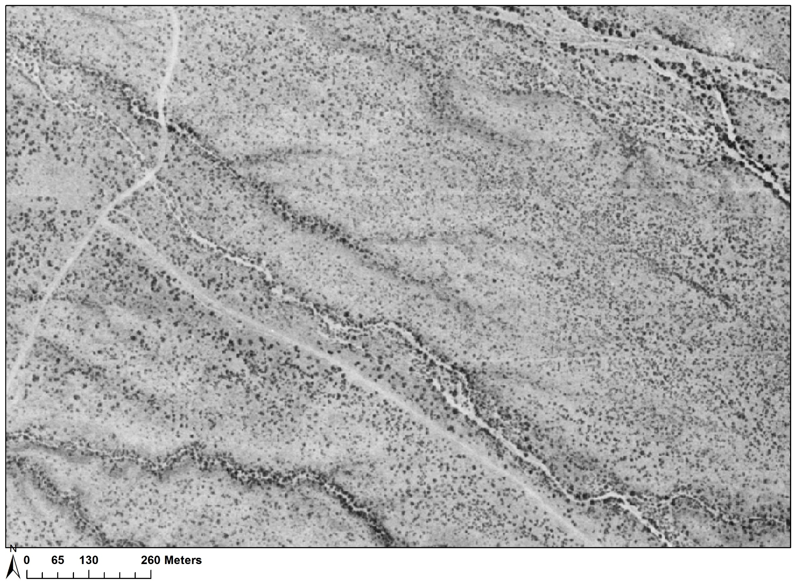

Slide 7
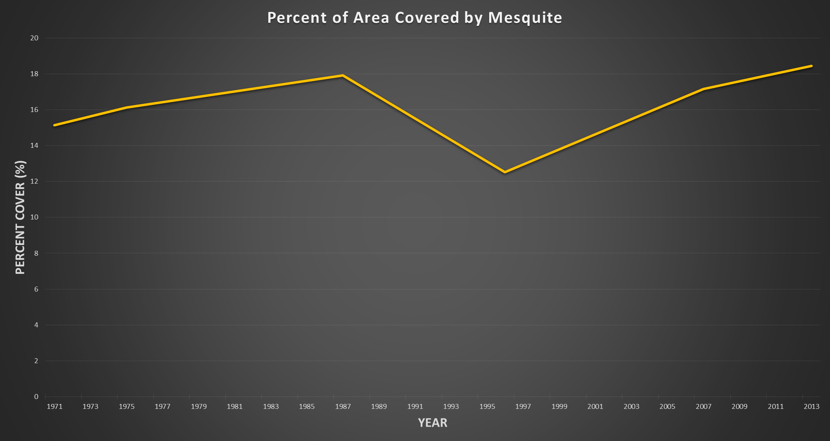
Results_______________________________

Slide 8
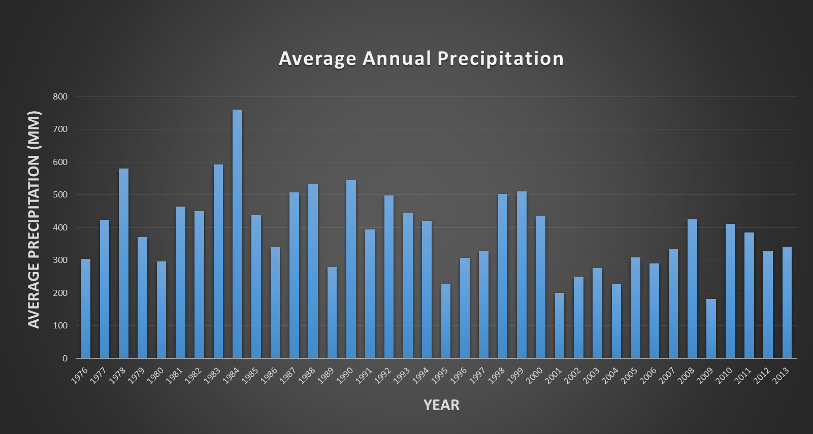

Slide 9


Slide 10
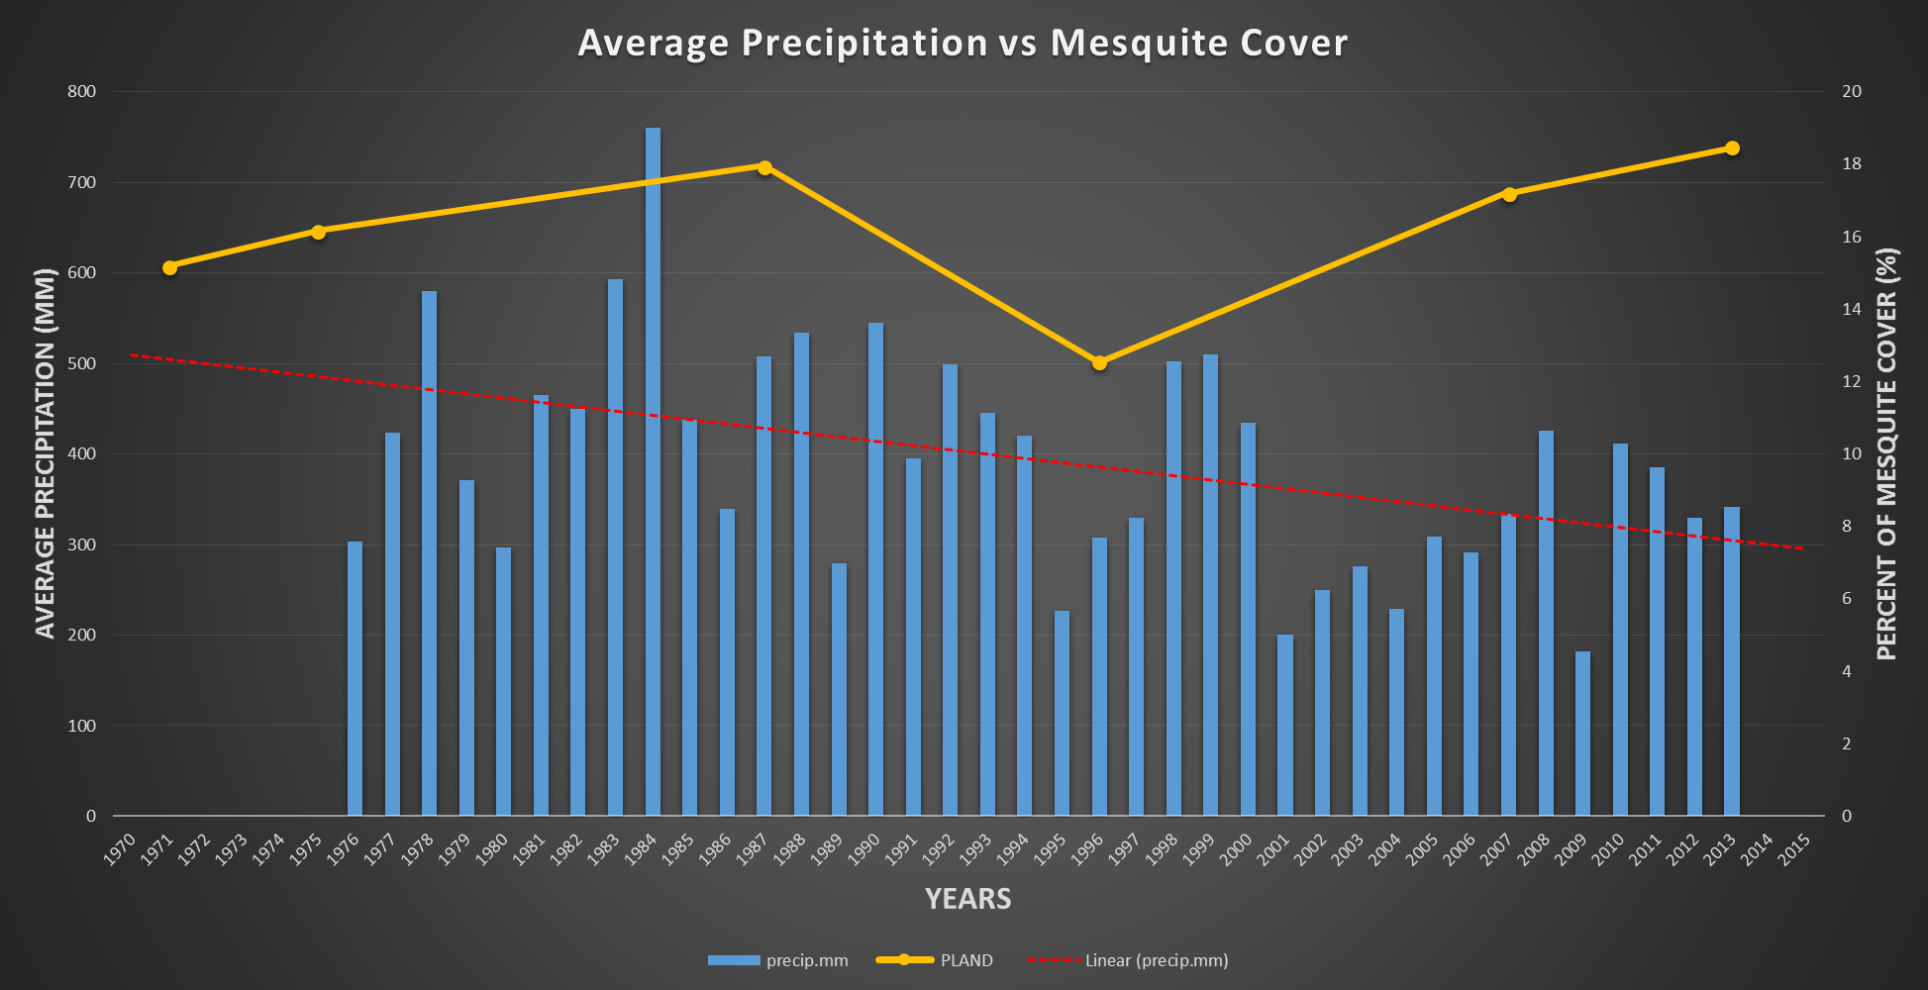

Slide 11
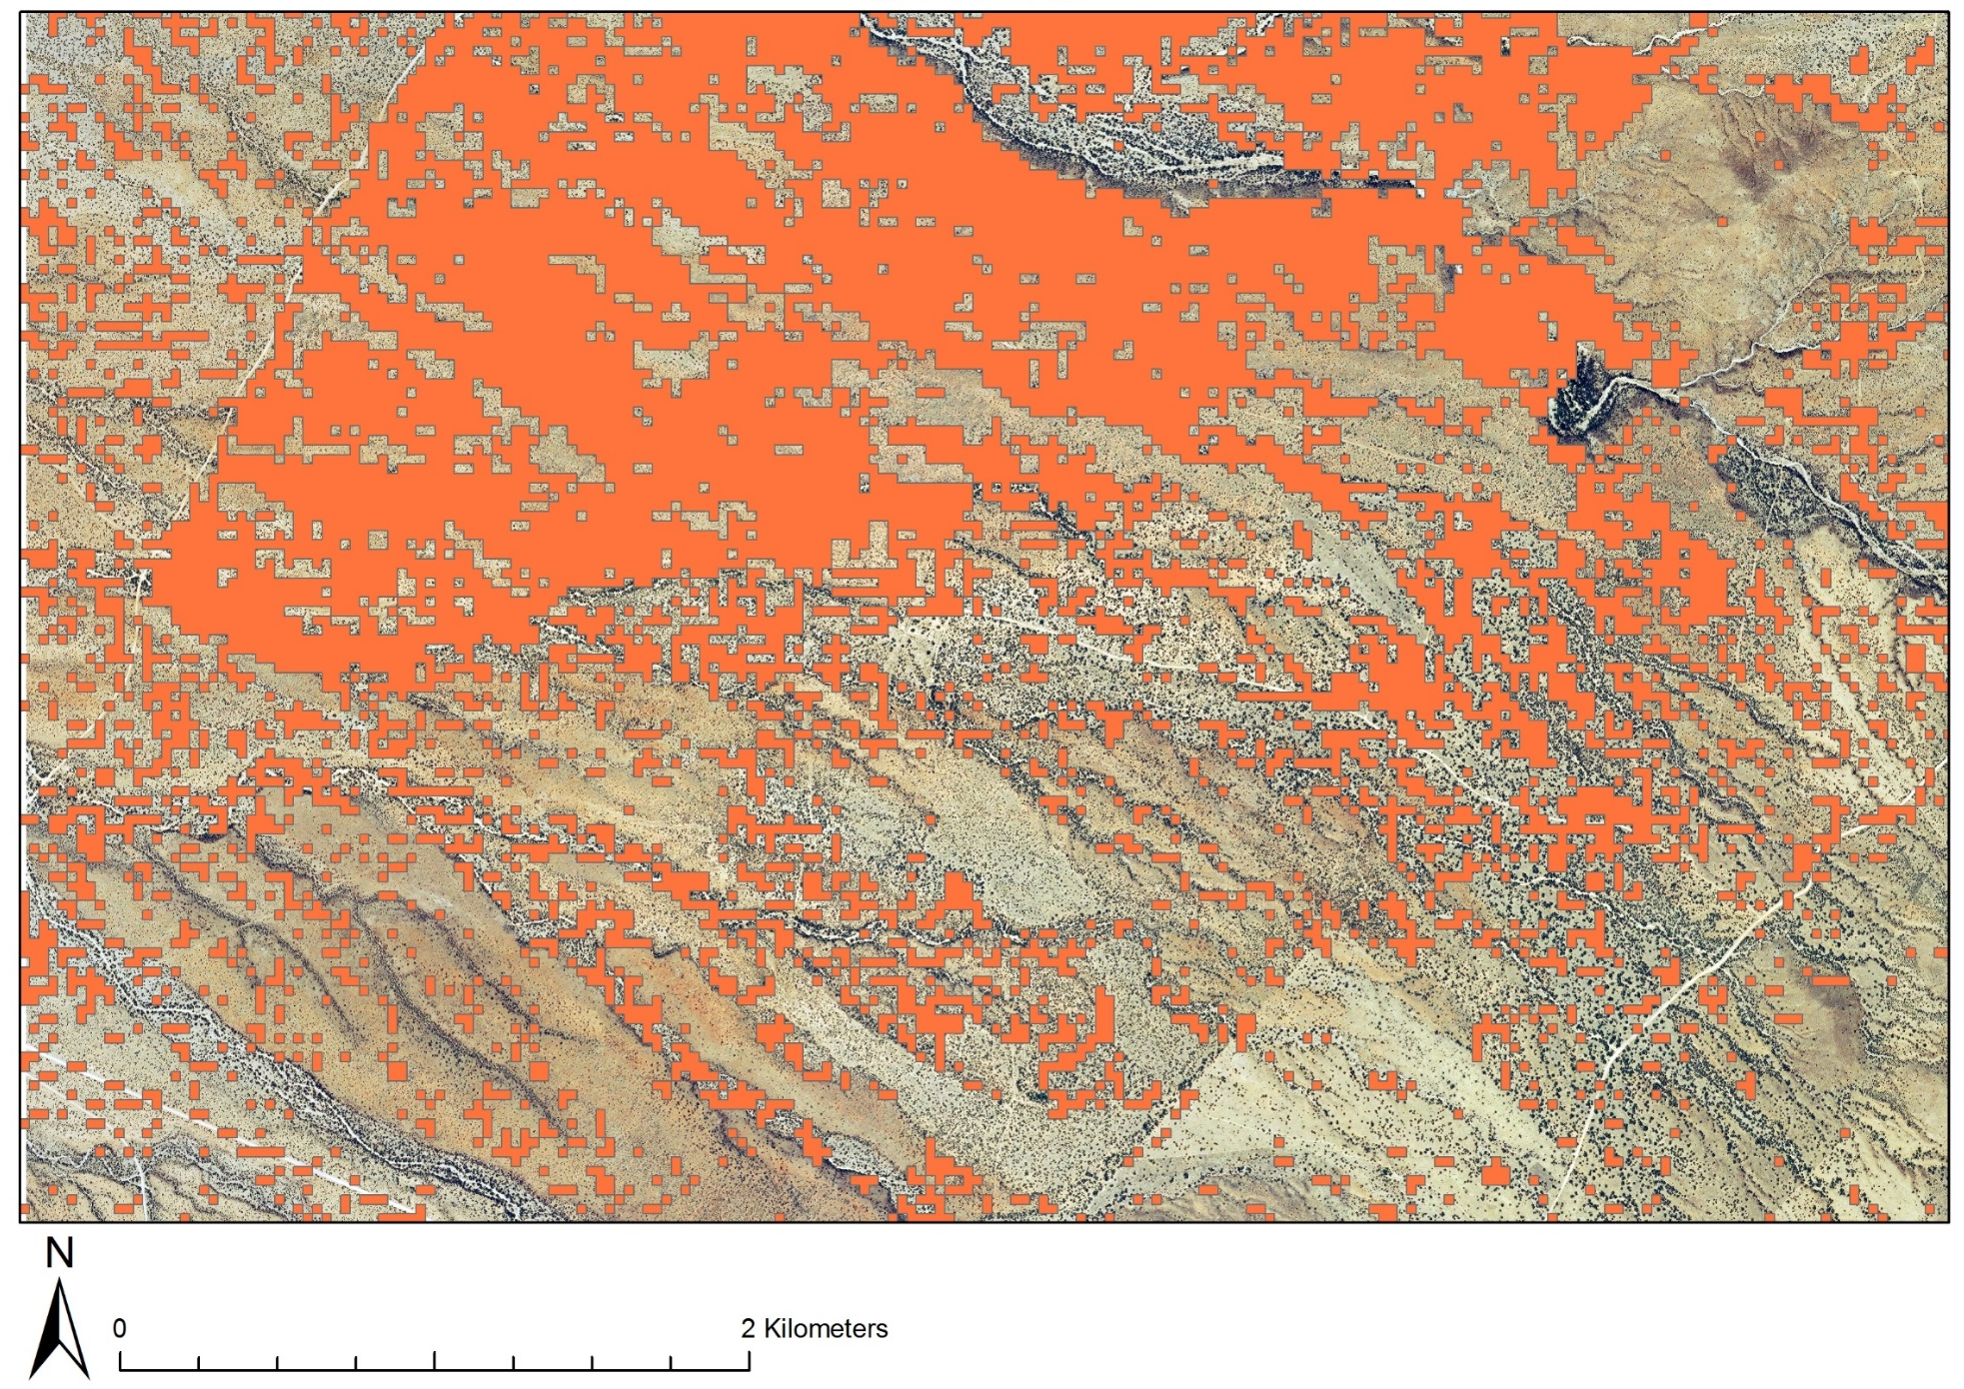

Slide 12
Conclusions
Velvet mesquite will continue to proliferate despite dry conditions.
Through high resolution imagery and observations we can monitor the rate of woody cover and its response to disturbances to better manage rangelands.

Slide 13
Acknowledgements
Dr. Steve Archer and Dr. Adam Naito
The College of Agriculture and Life Sciences
The USDA and USGS
NASA and the Arizona Space Grant Consortium

